Slide 1
Algorithms
Definition and Examples

Slide 2
Algorithm
In mathematics and computer science, an algorithm is a
self-contained step-by-step set of operations
to be performed.

Slide 3
Algorithm
Algorithms exist that perform
Calculation
Data processing
Automated reasoning
etc.

Slide 4
Algorithm
The words 'algorithm' and 'algorism' come from the name al-Khwārizmī. Al-Khwārizmī (Persian: خوارزمی‎‎, c. 780-850) was a Persian mathematician, astronomer, geographer, and scholar.

Slide 5
Algorithm
An algorithm is an effective method that can be expressed within a finite amount of space and time and in a well-defined formal language for calculating a function.

Slide 6
Algorithm
Algorithm characteristics
Initial state
Initial input
Instructions / Commands / Business logic
States (finite number)
Output
Ending state

Slide 7
Algorithm
Algorithm output types
Deterministic
Randomized

Slide 8
Algorithm
Algorithm - definition
An algorithm is a set of instruction to solve a problem
When instructions are followed, it must stop eventually with an answer

Slide 9
Algorithm
What makes a good algorithm:
Correctness
Efficiency

Slide 10
Algorithm
Algorithm efficiency
Speed - method that takes less time
Space - method that uses less memory
Code - method that is shortest to describe
Speed is usually the most important factor

Slide 11
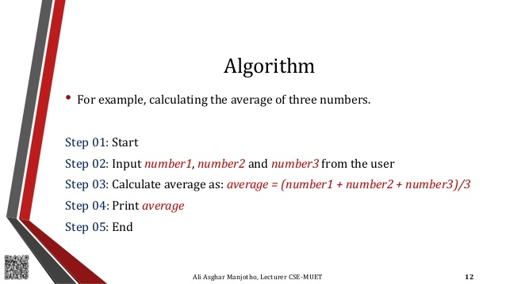
Algorithm - example 01

Slide 12
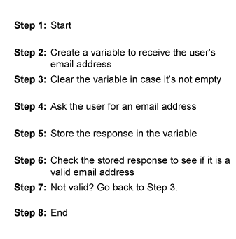
Algorithm - example 02

Slide 13
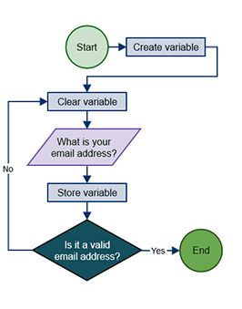
Algorithm - example 03

Slide 14
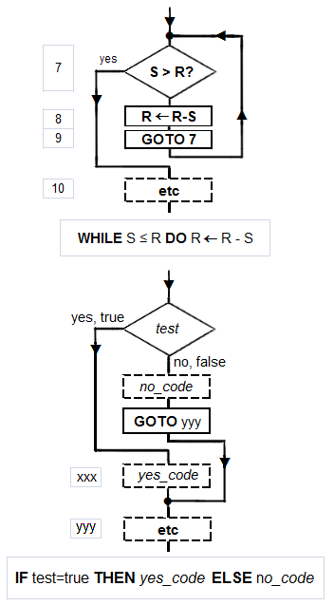
Algorithm - example 04

Slide 15
Algorithm - example 05
Algorithm LargestNumber Input: A list of numbers L. Output: The largest number in the list L.
if L.size = 0 return null largest ← L[0] for each item in L, do if item > largest, then largest ← item return largest

Slide 16
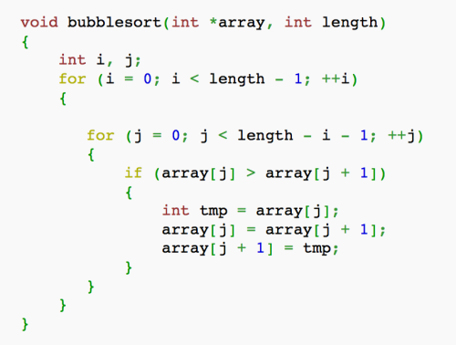
Algorithm - example 06

Slide 17
Tasks
Find Min and Max elements in the array
Calculate average value of the array items
Swap 2 arrays items
Add element into Stack data structure
Remove element from Stack data structure
Add element into Binary tree
Swap all elements of 2 arrays
Put smallest element as 1st item in the array

Slide 18
Links
https://en.wikipedia.org/wiki/Algorithm
https://www.khanacademy.org/computing/computer-science/algorithms

